Slide 1
Introduction To Python
By M.Guhan

Slide 2
Introduction
Python is a popular programming language. It was created by Guido van Rossum, and released in 1991.
It is a high level, interpreted programming language known for its simplicity and readability.
Python emphasizes code clarity and allows developers to express concepts in fewer lines of code compared to other languages.

Slide 3
Why Python
Python has a simple syntax similar to the English language.
Python has syntax that allows developers to write programs with fewer lines than some other programming languages.
Python runs on an interpreter system, meaning that code can be executed as soon as it is written. This means that prototyping can be very quick.

Slide 4
Python Features
Easy to Learn Clean syntax that resembles plain English.
Used in web development, data science, automation, AI and more.
Rich ecosystem of packages like NumPy, Pandas, Django and TensorFlow.
Runs on Windows, macOS, Linux, and more.

Slide 5
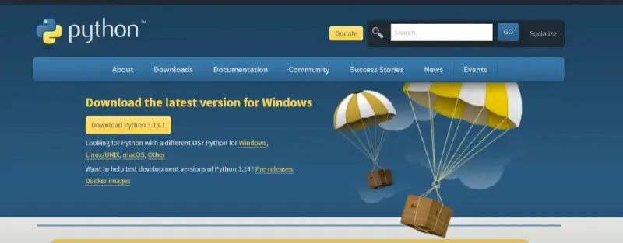
Installation
Open your browser and visit the Python download page: python.org/downloads.
Select the latest Python version whichever is the latest stable version available.
Click on the version to download the installer.

Slide 6
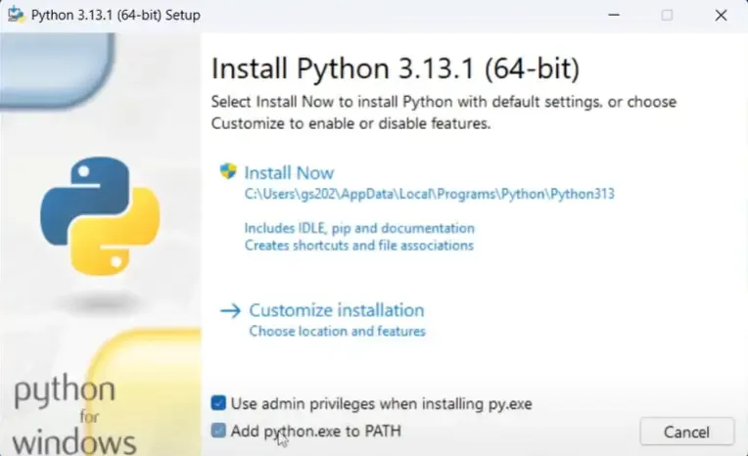
Once the download is complete, run the installer program. On Windows, it will typically be a .exe file.
It will start installing Python on Windows.
After installation is complete click on Close.
After installing Python, we can launch the Python Shell by searching for "IDLE" in the "Start" menu and clicking on it.

Slide 7
Python Syntax
Python uses indentation to indicate a block of code.
the indentation in Python is very important.
For Ex,
if 5 > 2: print("Five is greater than two!")----# correct formate.
if 5 > 2: print("Five is greater than two!")---------# syntax error.
Python will give you an error if you skip the indentation.

